Slide 1
Admin info

Slide 2
Contents
How to enable macros

Slide 3
Enabling Macros

Slide 4
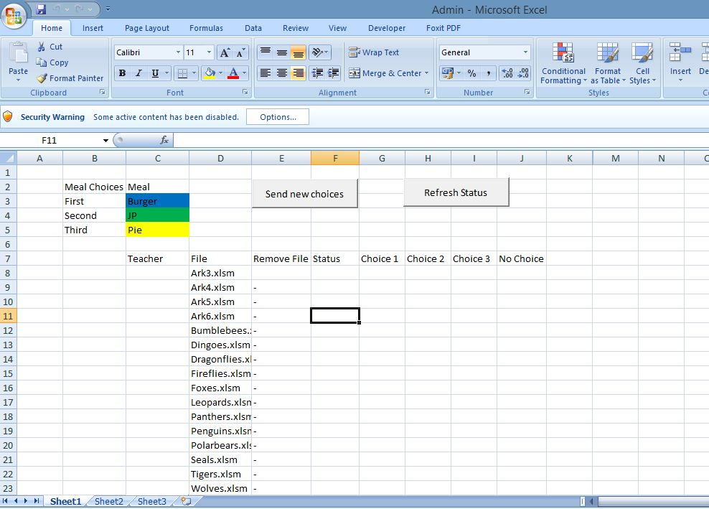
Inital warning without macros enabled
Without macros the buttons and functionality won’t be enabled

Slide 5
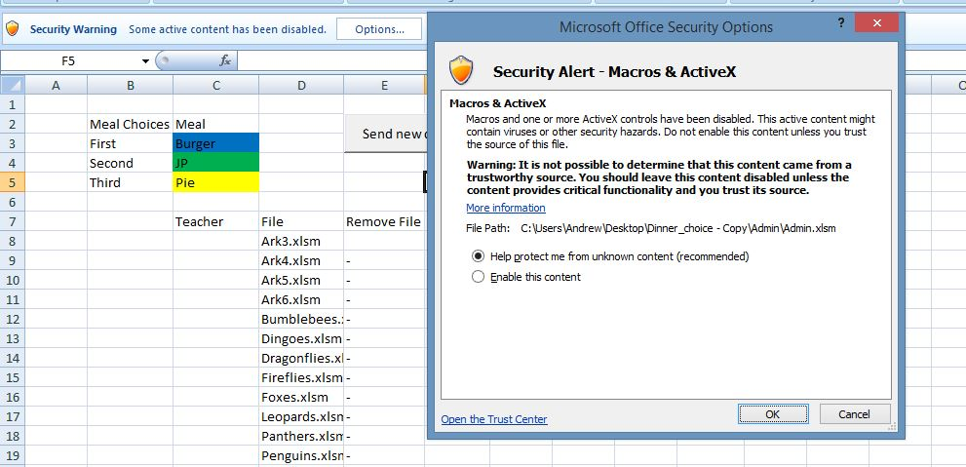
Simple enabling (not the best way)
Click on “Enable this content” and ok

Slide 6
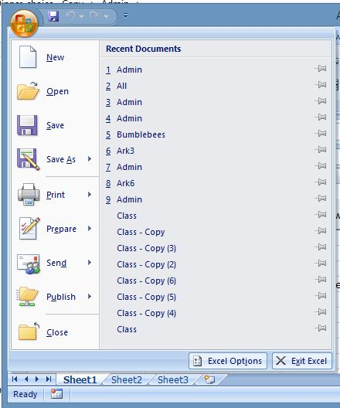
Long term you should trust the location by following these steps
Firstly click on the office button
Then open “Excel Options”

Slide 7
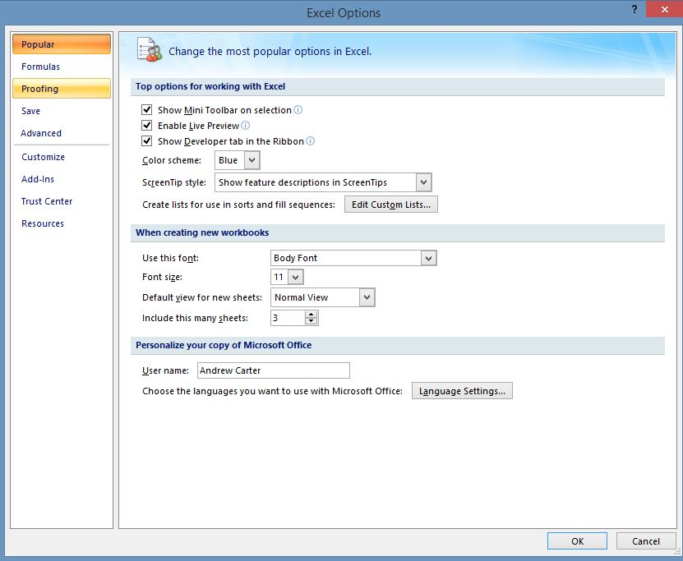
Goto Trust Center

Slide 8
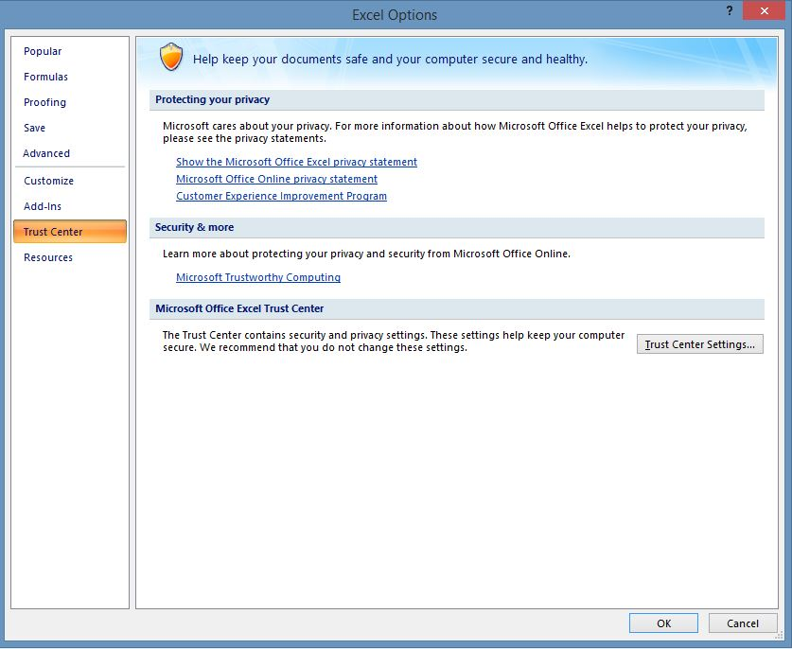
Should get you here

Slide 9
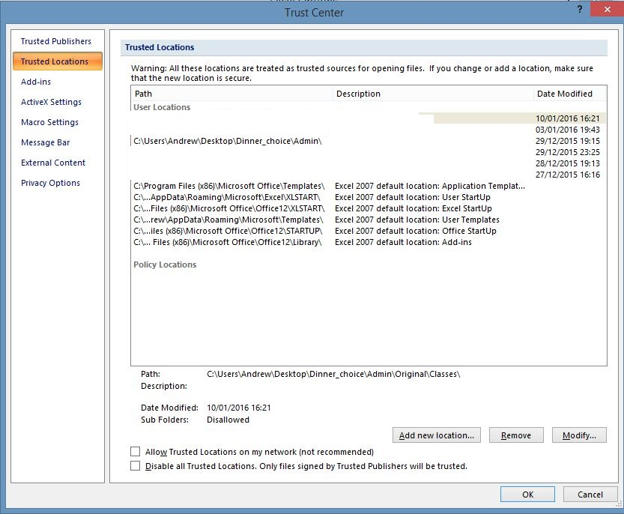
Add new location
For admin this should be the directory:
Dinner_choices\admin
I.e. Where admin.xlsm is located.

